Slide 1
Artificial Intelligence Introduction & Motivation
Week_01
Task No. 1 to 11
Instructor: Engr. Najam Aziz

Slide 2
Course Intro

Slide 3
Artificial
Intelligence
Man - made
“a man-made thinking power."
Thinking Power
"Branch of computer science by which we can create intelligent machines which can behave like a human, think like humans, and able to make decisions."
To create the AI, first we should know that how intelligence is composed:
Intelligence is an intangible part of our brain and is a combination of Reasoning, learning, problem-solving perception, language understanding, etc.
To achieve the above factors for a machine or software Artificial Intelligence requires the following discipline:
Mathematics, Biology, Psychology, Sociology, Computer Science, Neurons Study, Statistics

Slide 4
What is AI?
Artificial Intelligence (AI)
- Intelligent behavior in artifacts
-”Design computer programs to make computers smarter”
-Study of how to make computers do things at which, at the moment, people are better”
Intelligent Behavior
-perception, reasoning, learning, communicating, acting in complex environments
Long term goals of AI
-Develop machines that do things as well as humans can or possibly even better
-understand behaviors

Slide 5
Why AI?
Following are some main reasons to learn about AI:
With the help of AI, you can create such software or devices which can solve real-world problems very easily and with accuracy such as health issues, marketing, traffic issues, etc.
With the help of AI, you can create your personal virtual Assistant, such as Cortana, Google Assistant, Siri, etc.
With the help of AI, you can build such Robots which can work in an environment where survival of humans can be at risk.
AI opens a path for other new technologies, new devices, and new Opportunities.

Slide 6
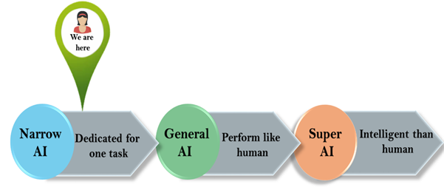
Goals of AI
Following are the main goals of Artificial Intelligence:
Replicate human intelligence
Solve Knowledge-intensive tasks
An intelligent connection of perception and action
Building a machine which can perform tasks that requires human intelligence such as:
Proving a theorem
Playing chess
Plan some surgical operation
Driving a car in traffic
Creating some system which can exhibit intelligent behavior, learn new things by itself, demonstrate, explain, and can advise to its user.

Slide 7
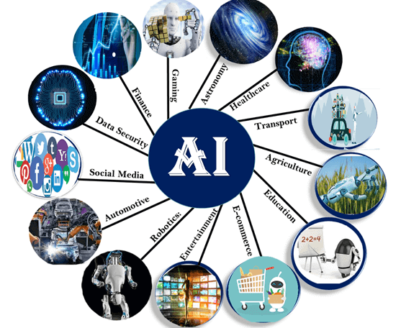
Application of AI

Slide 8
Course Objective

Slide 9
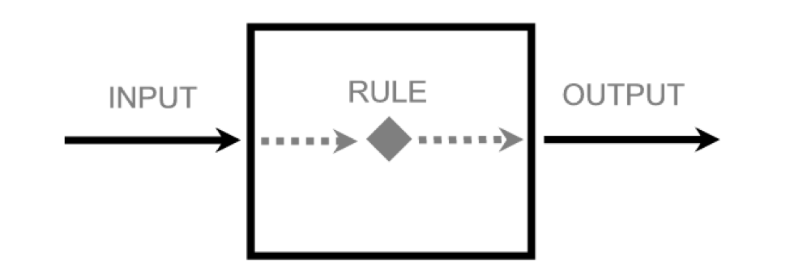
We have some input/data, want some output/desired. So, we need a Rule in between.
Input = Data:
Raw facts and Figures
Any unprocessed fact, value, text, sound or picture that is not being interpreted and analyzed.
Output = Desired output:
What we want.
What is out objective
Rule:
A rule is a regulation or direction for doing some particular activity.
Example: NAVTTC AI Course

Slide 10
Course Contents

Slide 11
Human Intelligence
Inbuilt (Biological)
Simulation
Machine Intelligence
We create (Logical)
How?
Programming language (To talk to Machines)
Python
Libraries (Collections of prewritten code that users can use to optimize tasks.)
Numpy
Pandas
Matplotlib
Tensorflow/Keras
Techniques (a way of carrying out a particular task)
Machine Learning
Deep Learning
Course Content

Slide 12
Work Ethics
2:00 PM = 2:00 PM
No Non-Seriousness
There are no silly questions
Attendance >= 95%
Class Timing: 2:00 - 7:00 PM

